Slide 1
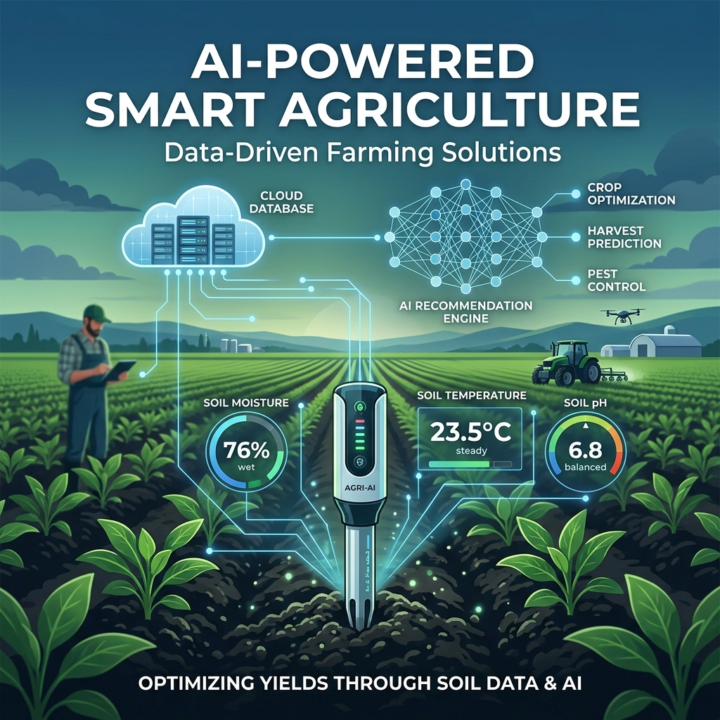
FINAL YEAR CSE PROJECT PROPOSAL
IoT-Based Smart Soil
Analysis and AI-Powered
Crop Recommendation
System
STUDENTS:
▪ Jeba Takia (210104)
▪ MD Mushfiqur Rahman Mahim (210131)
INSTITUTION:
Department of Computer Science and Engineering
Daffodil Institute of IT
Session: 2020-21

Slide 2
PROJECT PROPOSAL
Introduction to Smart Agriculture
The Paradigm Shift
Smart agriculture integrates digital technologies, real-time sensing, and analytical modeling to automate and optimize farming practices. As global food demand rises, farming must evolve from a reactive industry to a predictive, data-driven science.
Key Technology Pillars:
▪ IoT Sensors: Continuous field telemetry (pH, Moisture, Temp).
▪ Machine Learning: Smart predictive algorithms for cropping.
▪ Cloud Integration: Centralized telemetry archives and API access.
▪ Automation: Precision resource distribution (smart irrigation).
Traditional Farming Bottlenecks
Conventional farming practices in developing regions heavily depend on historical guesswork, visual cues, and generic seasonal patterns, leading to sub-optimal resource usage and crop failure.
Critical Challenges Faced:
▪ Soil Nutrient Ignorance: Farming without knowing pH or moisture levels.
▪ Resource Wastage: Over-watering or excessive use of chemical fertilizers.
▪ Economic Risk: High crop failure rates due to mismatched soil compatibility.
▪ Unpredictable Climate: Lack of adaptivity to shifting local weather.
02 / 15

Slide 3
PROJECT PROPOSAL
Problem Statement
01
Guesswork Cultivation
Farmers often grow traditional crops year after year without validating if the soil has degraded. This lack of crop-to-soil compatibility testing directly leads to low yield rates and agricultural economic strain.
02
No Soil Telemetry Info
Soil properties fluctuate dynamically due to watering, fertilization, and climate. Lab-based soil testing takes weeks and is expensive, leaving farmers with no access to real-time, actionable chemical and moisture telemetry.
03
Technology Adoption Gap
While advanced agricultural sensors and AI technologies exist, they are isolated from local farmers. There is a critical shortage of low-cost, integrated hardware and simple bilingual mobile-friendly dashboard systems.
03 / 15

Slide 4
PROJECT PROPOSAL
Project Objectives
01. Real-Time Soil Monitoring
Deploy low-cost, high-precision IoT sensors to continuously capture critical soil parameters: pH, moisture content, and ambient temperature/humidity.
02. Cloud Database & Telemetry Logs
Establish a secure, lightweight cloud database to log all real-time field readings, forming a historical timeline for analysis and system auditing.
03. AI-Powered Crop Recommendation
Design and train an ML classifier (Random Forest/SVM) that processes real-time sensor parameters to recommend the most suitable crop and required fertilizers.
04. Web Dashboard Visualization
Develop an accessible web interface with real-time graphs, simple health scores, bilingual translation, and automated SMS alerts for soil degradation.
04 / 15

Slide 5
PROJECT PROPOSAL
Proposed System Architecture
The data starts at the sensors, is processed by ESP32, uploaded to the cloud database, analyzed by AI, and served to the farmer dashboard.
01. SENSORS
02. GATEWAY
03. CLOUD DB
04. AI ENGINE
05. DASHBOARD
pH Sensor
Soil Moisture
DHT22 Temp
ESP32 MCU
Analog ADC
Wi-Fi Upload
MySQL / Postgre
Secure API
JSON Logging
Python ML API
Random Forest
Inference Model
HTML/CSS/JS
Real-time Alerts
Visual Graphs
Data Flow Summary:
1. Soil values are captured analogously. 2. ESP32 digitizes and transmits via Wi-Fi (HTTP POST/MQTT). 3. Cloud server stores data points in a secure DB. 4. Flask API triggers inference. 5. Recommendations and real-time parameters update on the dashboard.
05 / 15

Slide 6
PROJECT PROPOSAL
Hardware Architecture & Sensors
ESP32 NodeMCU Microcontroller
▪ Core: Dual-core Tensilica LX6 32-bit MCU with integrated Wi-Fi and Bluetooth.
▪ Pinouts: Multi-channel 12-bit ADC for sensor calibration and digital GPIOs.
▪ Purpose: Acts as the central node for sensor calibration, signal digitizing, and HTTP data transmission.
Capacitive Soil Moisture Sensor (v1.2)
▪ Tech: Capacitive measurements prevent probe oxidation and corrosion.
▪ Principle: Measures dielectric permittivity of surrounding soil to estimate water content percentage.
▪ Purpose: Signals irrigation frequency requirements.
Soil pH Sensor Probe
▪ Tech: High-precision glass electrode analog probe with signal amplifier.
▪ Output: 0-5V analog signal proportional to hydrogen-ion activity (pH scale 0-14).
▪ Purpose: Key driver for crop suitability and fertilizer recommendation.
DHT22 Temperature & Humidity Sensor
▪ Specs: Temperature range -40 to 80°C (+-0.5°C); Humidity range 0-100% (+-2% RH).
▪ Digital: Single-bus interface delivers digitized environmental parameters.
▪ Purpose: Analyzes microclimate to determine transpiration index.
06 / 15

Slide 7
PROJECT PROPOSAL
Software Environment & Core Stack
Firmware & Backend Pipeline
▪ Arduino IDE (C/C++): Program ESP32 for analog calibration, digital filtering, Wi-Fi reconnection logic, and REST API transmission.
▪ Python Flask / Node.js API: Lightweight backend server. Handles incoming JSON sensor payloads, routes requests, and exposes REST endpoints for the client dashboard.
▪ MySQL / PostgreSQL Database: Relational structure with tables storing client profile details, ESP32 device keys, logged soil data points, and recommendations log.
Visualization & ML Pipeline
▪ HTML5, CSS3, JavaScript (ES6+): Responsive front-end built using CSS grid, flexbox, and Chart.js for real-time visualization graphs.
▪ Machine Learning Suite (Scikit-Learn, Pandas, Numpy): Used to clean agricultural soil datasets, perform feature scaling, train classifiers, and serialize the model for Flask integration.
▪ Twilio / SMS API Gateway: Integrates custom notification loops to automatically push critical SMS alerts to registered farmers during extreme conditions.
07 / 15

Slide 8
PROJECT PROPOSAL
System Workflow & Process Pipeline
Step 1: Data Sensing
Sensors sample pH, moisture, and temperature ambient levels continuously. Analog values are filtered to remove background noise.
Step 2: Transmission
ESP32 bundles sensor readings into a JSON payload and transmits it securely via HTTP POST request to the cloud endpoint.
Step 3: Cloud Logging
The Flask server parses the request, validates the device token, and logs the telemetry with timestamps into the SQL database.
Step 4: AI Model Inference
The server triggers the ML inference engine. The pre-trained classifier matches soil parameters against crop compatibility arrays.
Step 5: Recommendation
AI outputs the optimal crop type along with specific fertilizer ratios. Warnings are triggered if severe anomalies are detected.
Step 6: Dashboard Update
The Web Dashboard pulls fresh logs via AJAX/WebSockets. Charts re-render, and crop advisory reports update instantly.
08 / 15

Slide 9
PROJECT PROPOSAL
Key Features & Platform Capabilities
Real-time Telemetry
Provides continuous logging of essential soil chemistry and ambient readings with graphical curves.
AI Recommendation
Utilizes classification algorithms matching multi-parameter inputs against crops with high precision.
Fertilizer Optimizer
Calculates required NPK adjustments based on the difference between present soil and crop ideals.
Irrigation Advisory
Automated alert recommendations for watering based on current moisture content and air humidity profiles.
Soil Health Scoring
Aggregates pH variance, water logging, and moisture trends into a unified, clean Health Score (1-100).
Bilingual Dashboard
Features toggleable English & Bangla views and mobile layout optimization for rural farmers.
09 / 15

Slide 10
PROJECT PROPOSAL
AI Crop Recommendation Engine
Decision Logic & Classifiers
The AI module uses supervised learning to map soil parameters to the target crop. Machine learning models analyze multi-dimensional bounds to generate recommendations.
Core ML Classifiers Evaluated:
▪ Random Forest Classifier: High accuracy, robust against outliers, and works efficiently with structured soil data.
▪ Support Vector Machine (SVM): Strong margin separation bounds.
▪ Gaussian Naive Bayes: Fast inference with probabilistic outputs.
▪ Decision Tree: Transparent routing logic matching local farming rules.
INPUT PARAMETERS
pH, Moisture %, NPK Ratios, Temperature, Humidity
RANDOM FOREST / SVM CLASSIFIER MODEL
Calculates probabilistic score matrices for 22+ crop categories
GENERATED SYSTEM OUTPUTS
1. Recommended Crop: Rice, Maize, Lentils, Cotton, etc.
2. Fertilizer Advisory: Specific NPK ratio adjustments.
3. Irrigation Command: Active watering schedule.
10 / 15

Slide 11
PROJECT PROPOSAL
Business Model & Strategic Prospects
PILLAR 1
Smart Farming Kit
▪ One-Time Purchase: Sell localized, pre-calibrated ESP32 and sensor enclosures directly to commercial farms and local crop growers.
▪ Plug-and-Play Setup: Users set up the device and connect to local Wi-Fi without needing technical support.
PILLAR 2
SaaS Subscription
▪ Tiered Subscription Model: Free basic level showing parameters. Premium level offering historical trend analysis, PDF soil health cards, and multi-device management.
▪ Fertilizer API Access: Access for commercial fertilizer distributors looking to target specific regions.
PILLAR 3
NGO & Government Contracts
▪ Subsidized Distribution: Collaborate with agricultural ministries and microfinance NGOs to distribute kits to rural farming cooperatives.
▪ Regional Data Dashboard: Package regional soil mapping data for policy makers planning agricultural support.
11 / 15

Slide 12
PROJECT PROPOSAL
Future Roadmap & Enhancements
Phase 1: Weather API
Incorporate live satellite weather forecasting (rainfall probability, frost warnings) into recommendation loop.
Phase 3: Smart Irrigation
Integrate a solenoid valve circuit controller to enable automatic irrigation when moisture falls below thresholds.
Phase 2: Mobile App
Develop a native mobile application using React Native to offer push alerts and offline telemetry caching.
Phase 4: NPK Sensors
Replace manual estimates with spectrophotometric optical sensors that measure soil NPK levels in real time.
12 / 15

Slide 13
PROJECT PROPOSAL
Project Development Timeline
Tasks / Phases | Month 1 (Planning) | Month 2 (HW Setup) | Month 3 (AI & Backend) | Month 4 (Dashboard & QA)
Literature Review & Proposal | ACTIVE DEVELOPMENT
Hardware Calibration & Driver Config |  | ACTIVE DEVELOPMENT
AI Model Training & Dataset Cleaning |  | ACTIVE DEVELOPMENT
Cloud Server & DB Schema Setup |  |  | ACTIVE DEVELOPMENT
Web Client Dashboard & Twilio Alerts |  |  | ACTIVE DEVELOPMENT
System Integration, QA Testing & Defense |  |  |  | ACTIVE DEVELOPMENT
13 / 15

Slide 14
PROJECT PROPOSAL
Expected Outcomes & Project Impact
Maximizing Agricultural Yield
By replacing guesswork with empirical, AI-recommended crop compatibility, the project expects a direct increase in harvest quality and density per acre, reducing crop failures.
Resource & Fertilizer Optimization
By calculating the exact nutrients required for the chosen crop, farmers avoid chemical over-fertilization, preventing long-term soil acidification and reducing cost.
Empirical Regional Telemetry Data
Logging telemetry continuously compiles structured geological archives of the farm, opening opportunities for academic research, soil decay studies, and predictive analytics.
Farmer Digital Inclusivity
The bilingual interface, clear color-coded dials, and automatic SMS notification system break down technology barriers, bringing modern IoT power to traditional farming.
14 / 15

Slide 15

Thank You!
Questions & Answers
IoT-Based Smart Soil Analysis and AI-Powered Crop Recommendation System
Students:
▪ Jeba Takia (210104)
▪ MD Mushfiqur Rahman Mahim (210131)
Department of Computer Science and Engineering
Daffodil Institute of IT
Session 2020-21
15 / 15

